Slide 1


THE ACPR IN A FEW WORDS
Introducing the Autorité de contrôle prudentiel et de résolution
COMMUNICATION UNIT - 12/2021

Slide 2
What is the ACPR?
The Autorité de contrôle prudentiel⁽¹⁾ et de résolution⁽²⁾⁽³⁾ is an administrative authority attached to the Banque de France responsible for carrying out the supervision of the banking and insurance sector in France
(1) Prudential supervision consists in monitoring the financial soundness of institutions, in particular their capital base, liquidity and risk management arrangements in accordance with the regulations in force
(2) Resolution consists in the implementation of crisis prevention and resolution measures as alternatives to liquidation, in the fields of banking and insurance
(3) French prudential control and resolution Authority

Slide 3
WHY WAS ACP* CREATED IN 2010? (1/3)
July 2009
Following the global financial crisis of 2008, Christine Lagarde, the French Minister for the Economy, announced the creation of a new authority in France, tasked with the supervision of banks and insurers
3 objectives: - ensuring financial stability
- protecting customers
- strengthening French influence in international and European fora
March 2010
Establishment of the Autorité de contrôle prudentiel (ACP)
with a new competence: consumer protection
(control of the marketing of financial products)
Licensing Authorities
French credit institutions and investment firms Committee (CECEI)
& French insurance undertakings Committee (CEA)
+
Supervisory Authorities
French banking Commission
& French insurance and mutual insurance undertakings supervisory Authority (ACAM)
Merger
ACP =
* The ACP became the ACPR in 2013

Slide 4
What ARE THE key milestones TO remember? (2/3)
2010
Creation of 3 European supervisory agencies
The EBA, EIOPA and ESMA*
2013
The ACP is given a new mandate: resolution, and becomes the ACPR
2015
Entry into force of the Single Resolution Mechanism (SRM)
2011
Establishment of the joint ACP-AMF Unit dedicated to customer protection
2014
Entry into force of the Single Supervisory Mechanism (SSM)
*European Banking Authority - "EBA“
European Insurance and Occupational Pensions Authority - "EIOPA“
European Securities and Market Authority - "ESMA"

Slide 5
What are the key milestones to remember? (3/3)
2016
Creation of the Fintech Unit dedicated to Fintech undertakings (entry point for innovative project initiators) and innovation (to anticipate and adapt to changes in the sector and its players)
Extension of the ACPR’s resolution powers to the insurance sector
2020
First climate stress tests conducted with banks and insurers
Targeted measures to safeguard financial stability in light of the economic crisis caused by the
Covid-19 pandemic
2016
Creation of the Financial Stability Unit which coordinates the ACPR and the Banque de France’s financial stability efforts:
- risk analysis,
- macroprudential policy,
- international regulatory issues…
2021
Creation of a unified Directorate dedicated to the fight Against Money Laundering and to Countering Terrorist Financing (AML-CFT)

Slide 6
An authority attached to the BANQUE DE France (BDF), meaning?
  The Governor of the Banque de France, Mr François Villeroy de Galhau, is the Chairman of the ACPR,
  Mr Jean-Paul Faugère, Vice-Chairman of the ACPR, serves on the General Council of the Banque de France
  ACPR staff is employed by the Banque de France
  The ACPR uses the support functions of the BDF with a view to mutualising resources (HR management, property management, IT, etc.)
  The ACPR adopts its budget, which is annexed to that of the BDF
  The ACPR’s revenues consist mainly of contributions paid by supervised entities.
  Employment and resources caps are set by the French Parliament, and incorporated into the Finance Act
  The ACPR acts within the framework of the Banque de France’s missions:
Financial stability
ACPR
Monetary Strategy
Services to the economy

Slide 7

WHAT ARE THE ACPR’S MAIN missions? (1/2)
The ACPR performs four main missions of general interest:
1
Preserving financial stability, both that of the system as a whole
and that of each institution (banking and insurance sectors)
    Licensing new players:
    Carrying out the ongoing supervision of the financial position of supervised entities and ensuring the enforcement of prudential regulations
    Contributing to the development of prudential rules for banks and insurance companies, at the international and European level, in order to prevent risks pertaining to the stability of the financial system (systemic risks)
    Granting and managing changes to licenses, authorisations, registrations
    Ownership changes, mergers or portfolio transfers, governance decisions (appointment of effective managers and managers of key insurance functions)...
    collaborating with the AMF on several authorisation activities

Slide 8

WHAT ARE THE ACPR’S MAIN missions? (2/2)
2
Protecting the customers of banking and insurance undertakings
3
Combating money laundering and terrorist financing through the supervision of the preventive measures implemented by institutions
4
Implementing crisis prevention mechanisms for the banking and insurance sectors, as well as "resolution" mechanisms in the event of an institution’s bankrupcy
Notes:
- Add insurance resolution

Slide 9

What ARE ITS OTHER key tasks?
Representing France as a supervisory authority at the international and European level, contributing to the strengthening of financial sector regulations
Enhancing, sharing and disseminating our expertise in the financial sector in academia, among supervised institutions... (studies and research, conferences, seminars)
Contributing to the risk assessment of the financial system, taking into account emerging risks (cyber risk, climate risk)
Fostering dialogue, supporting Fintech players and preparing next generation supervision methods (Suptech)

Slide 10









WhICH regulatory framework FOR banking & INSURANCE supervision?
Highly harmonised international and European regulations
Definition of international standards
  BCBS
  Basel Committee
  on Banking Supervision
  International Association
  of Insurance Supervisors
  Financial action task force
  Intergovernmental AML-CFT
  body
Proposal and adoption of legislation at the European level
European Commission
European Council
European Parliament
Publication of guidelines, clarification of European directives or regulations, verification of their application by national supervisors
  European Banking Authority
  European Insurance and Occupational Pensions
  Authority
National implementation
  Law (especially for the transposition of directives),
  decrees, views, instructions, ACPR notices

Slide 11
At the operational level, how is supervision organised?
  In the European Union, the supervision of credit institutions takes place under the Single Supervisory Mechanism (SSM), which organises the supervision of banks between the ACPR and the ECB
Indirect supervision
ECB
Direct supervision
Exchange of information
ACPR
Joint Supervisory Teams (JSTs)
Joint ECB and ACPR teams
Less Significant Institutions (LSIs)
Significant institutions (SIs)
  The supervision of insurance undertakings and LSIs is directly conducted by the ACPR
Customer protection missions, as well as anti-money laundering and terrorist financing missions, are also carried out directly by the ACPR for both sectors (banking & insurance)
The Single Resolution Mechanism (SRM), the second pillar of the Banking Union, is based on the same principles as the SSM.

Slide 12
Why do we distinguish “significant BANKING INSTITUTIONS" from "LESS SIGNIFICANT INSTITUTIONS"?
The key issue of this classification is to identify institutions the failure of which is likely to cause a "systemic" crisis, either at a global scale or at the level of the European Union (cause significant disruptions to the financial system as a whole and to the economic activity of several countries)
Paribas BNP
BPCE
Crédit Agricole SA
Société Générale
4 global-level "systemic" banking groups
6 banking groups totalling 81% of the total assets of the French banking sector
Crédit Mutuel
La Banque Postale
10 "significant" institutions in France, totalling 87%
of the total assets of the French banking sector
HSBC
Bpi france
RCI Banque
SFIL
Sources: ECB, ACPR

Slide 13

What are the key figures OF THE ACPR FOR 2020? (1/2)
Headcount & BUDGET
+
1000
208.2
million EUR
budget
employees
(see Annex 3)
Authorisations & Sanctions
218
licensing and authorisations decisions
6
rulings made by the
sanctions committee
Source: 2020 annual report

Slide 14


What are the key figures of the ACPR for 2020? (2/2)
SUPERVISED INSTITUTIONS
657
supervised institutions
in the banking sector
(see Annex 2)
683
supervised insurance and mutual insurance undertakings
ON-site inspections
76
on prudential matters
64
on business practices
25
on the fight against money laundering and terrorist financing (AML-CFT)
Source: 2020 annual report

Slide 15
What are the ACpr’s decision-making bodies?
SUPERVISORY BODY
SANCTIONS COMMITTEE
Plenary session
Sectoral insurance sub-college ⁽²⁾
Plenary session
Restricted session ⁽¹⁾
Sectoral banking sub-college ⁽²⁾
RESOLUTION BODY
ADVISORY COMMISSIONS
Prudential cases
Plenary session
AML-CFT ⁽³⁾
Business Practices
Climate and Sustainable Finance
The supervisory body's restricted sessions cover individual issues that may have a significant impact on both the banking and insurance sectors or on financial stability as a whole. It is also tasked with examining issues relating to the supervision of financial conglomerates
The sectoral sub-colleges, one of which is dedicated to the banking sector and the other to the insurance sector, are tasks with appraising individual cases as well as general issues specific to their sector
(3) Combating money laundering and terrorist financing

Slide 16
Organization chart of the Secretariat General
General Secretariat of the ACPR
Supervision
Banking Supervision Directorates 1 and 2
On-site Inspection Delegation
Insurance Supervision Directorates 1 and 2
Cross-functional and Specialised Supervision Directorate
Anti-Money Laundering and Terrorist Financing Directorate
Business Practices Supervision Directorate
Quality and Methodology Division
Authorisation Directorate
Fintech Innovation Unit
Resolution Directorate
Sanctions Committee Division
Ante and post
supervision
Legal Affairs Directorate
International Affairs Directorate
Risk Analysis Directorate
Cross-sectional functions
Human Resources and Support Functions Directorate
Communication unit
Support Functions

Slide 17






Want TO KNOW MORE?
Visit our websites:
abe-infoservice.fr
acpr.bank-france.fr
A public service website dedicated to informing, alerting and guiding financial sector customers
Follow the ACPR on social media:

Slide 18
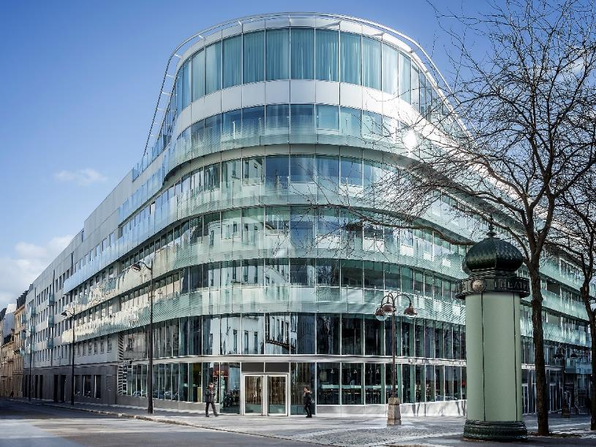

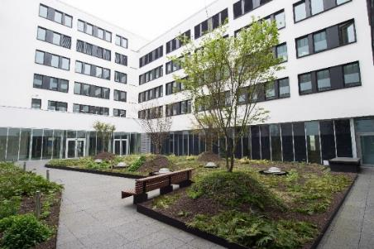
ANNEX 1: ACPR locations
Paris Saint-Lazare: place de Budapest (Intown building) and rue de Londres
Lille (ACPR offices in the BDF branch)
Tours (ACPR offices in the BDF branch)
ACPR offices, Intown building, Saint-Lazare

Slide 19
ANNEX 2: entities authorised to operate in France 31/12/20
Credit institutions (authorised in France and Monaco) | 341
Investment firms (authorised by the ACPR) | 93
Financing companies | 156
Payment institutions (authorised by the ACPR) | 44
Account information service providers | 8
Electronic money institutions (authorised by the ACPR) | 15
supervised institutions
in the banking sector
657
Other institutions authorised by the ACPR: 199 (5 third party financing companies and 194 bureaux de change)
Branches of European Economic Area institutions under freedom of establishment: 216
Insurers: insurance companies, supplementary occupational pension institutions, reinsurance companies, third-country branches (Insurance Code) | 281
Provident institutions (Social Security Code) | 33
Mutual undertakings (Mutual Insurers Code) | 369
683
supervised insurance and mutual insurance undertakings

Slide 20

ANNEX 3: focus on diversity at the ACPR BANQUE DE FRANCE
The Banque de France is committed to ensuring respect for diversity in all its forms, to fighting against discrimination, to promoting gender equality and guaranteeing a quality work environment.
More information on the Banque de France website (Corporate Social Responsibility section)
Did you know?
AT THE ACPR:
Average age: 40 years old
47.8% women / 52.2% men
As at 30/9/2021

